Slide 1

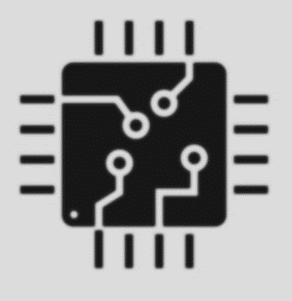

Seminar Series on
On recent trends in Integrated Circuit Design regime
Organized by: Department of Electrical Engineering NUCES ISLAMABAD
Department of Electrical engineering at NUCES-ISL and Integrated Circuit Design (ICD) Lab are organizing a seminar series on the recent trends and developments in the Integrated Circuit design regime. The primary objective of this seminar is to invoke the importance future of IC Design and Opportunities in Pakistan among the students and researchers. Seminar talk comprises of 26 online/on-campus talks over the span of fall 2020 semester. Web links for online talks will be shared before the start of each talk.
Started from 1 Sept, 2020
Online and On-Campus Talks over the Span of Fall 2020 Semester
Venue: MEDC Hall Room 118 FAST National University, A.K. Brohi Road, H-11/4, Islamabad.
Tentative Topics
The Future of IC Design and Opportunities for Pakistan
Self-Powered ICs and AC only Logic Gate and FFs
Active and passive Phase Shifter for 5G/6G NR
ESD Robustness in Silicon Integrated Circuits
RISC-V Architecture and its Salient Features
Spatial Sigma-Delta ADC for 5G/6G NR Applications
Wideband Multiband LNAs for SDR Applications
Low Power techniques for Analog and Mix signal Design
Techniques for Handling Noise and Variability in CMOS Transistors .
mm-Wave CMOS LNAs Design and Measurements
Layout Considerations in Analog and LP Circuits
Basics of Triboelectric Energy Harvesters
Approximate computing techniques, HW based Random number generators,
And more

